Slide 1
Historical Math Problems
What math do you think people thought about a thousand years ago? How about a hundred years ago?

Slide 2
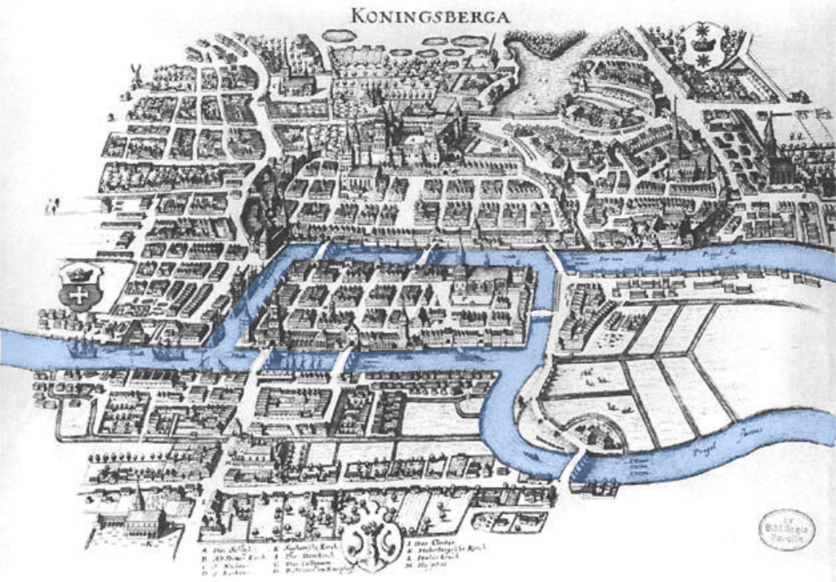
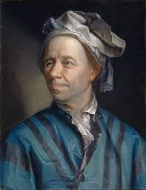
This is Euler!
This is a map of Königsberg Prussia from Euler’s time (1735-ish).
Notes:
https://scilogs.spektrum.de/hlf/the-bridges-of-konigsberg/

Slide 3
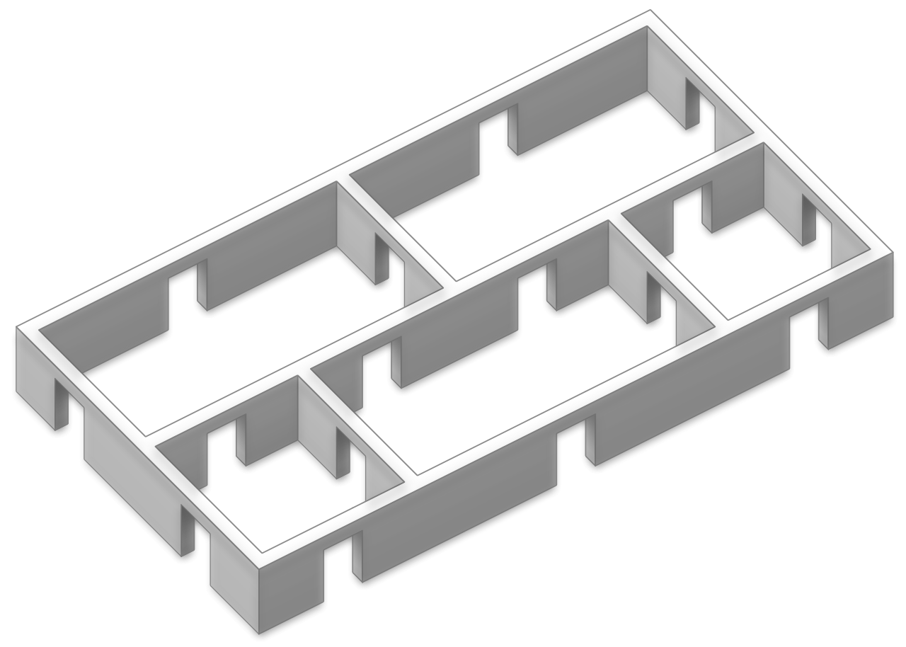
Can you walk through every doorway exactly once?
Notes:
Five room puzzle. (2021, April 26). In Wikipedia. https://en.wikipedia.org/wiki/Five_room_puzzle

Slide 4
The answer to both:
NO!
But how do we know that it is not possible?

Slide 5
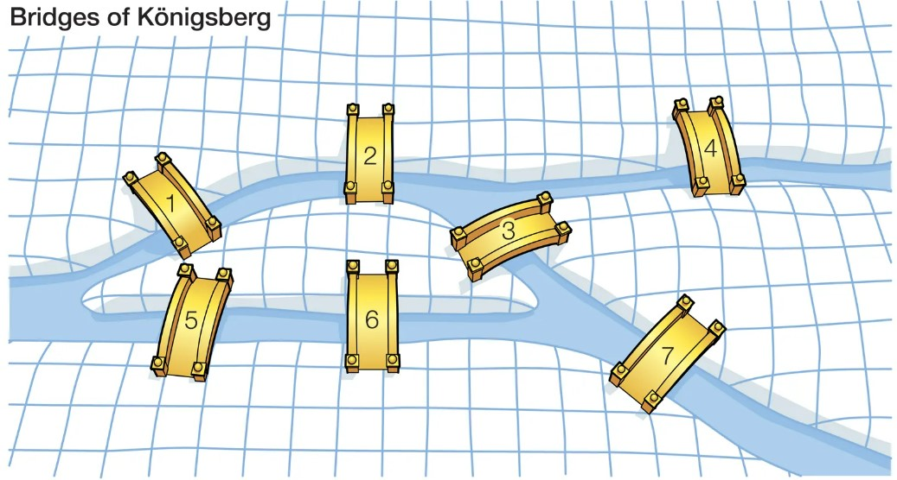
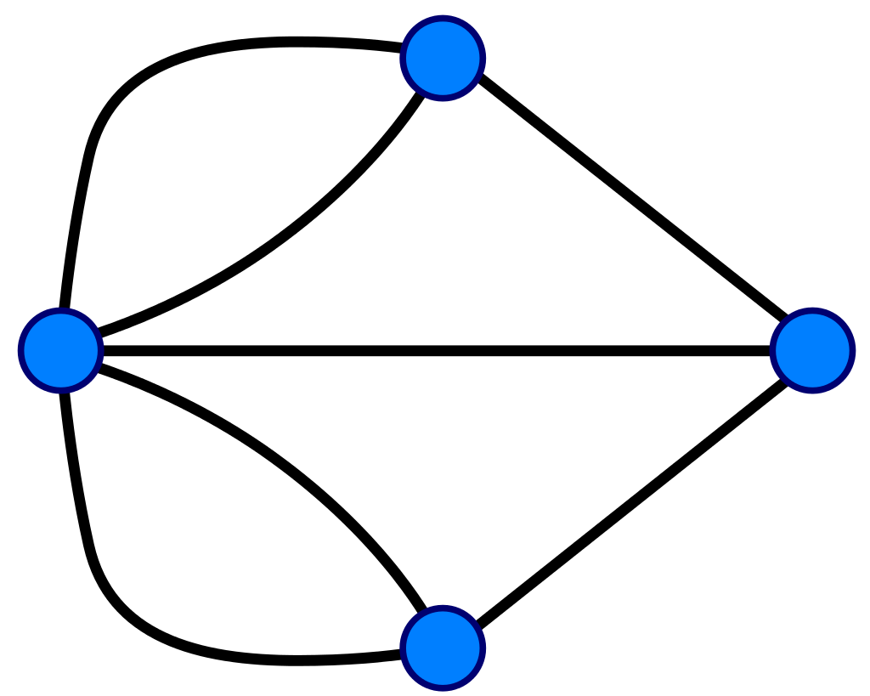
What information matters for the problem?
Notes:
2:
Seven Bridges of Königsberg. (2022, July 22). In Wikipedia. https://en.wikipedia.org/wiki/Seven_Bridges_of_K%C3%B6nigsberg

Slide 6
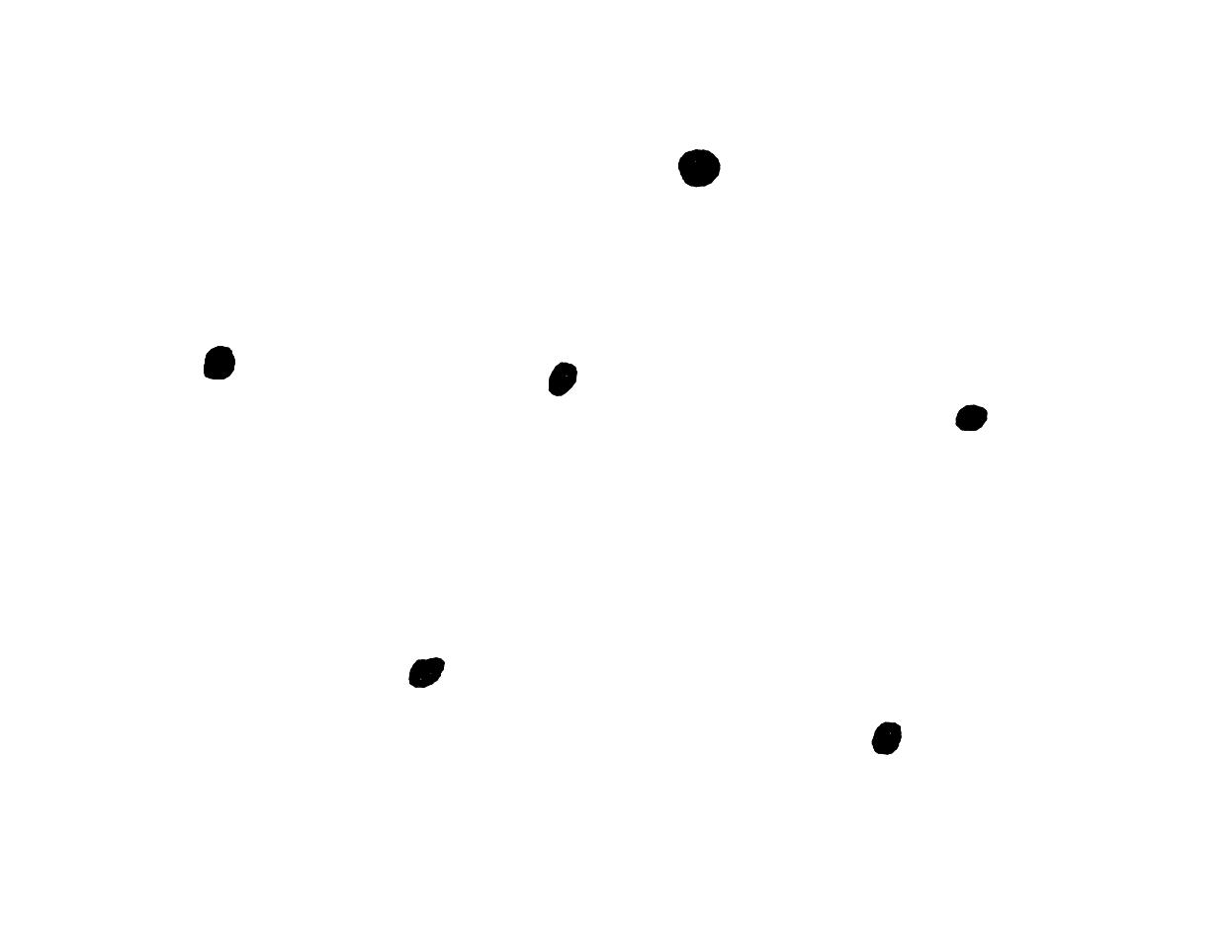
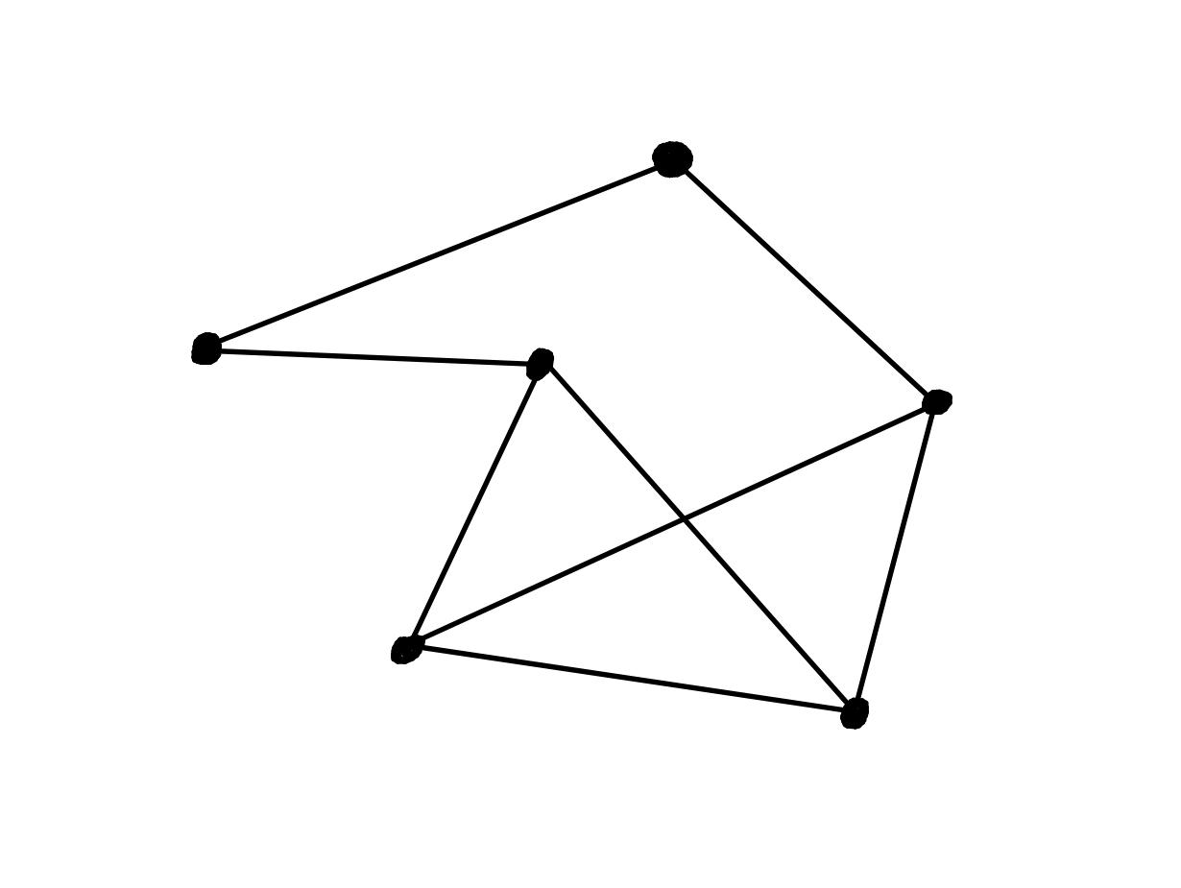
What is a graph?
We start with a bunch of dots. We call each one a vertex. We then connect the dots with a bunch of lines or loops. Each line or loop an edge. It is like playing connect the dots, but you can draw a lot more lines!

Slide 7
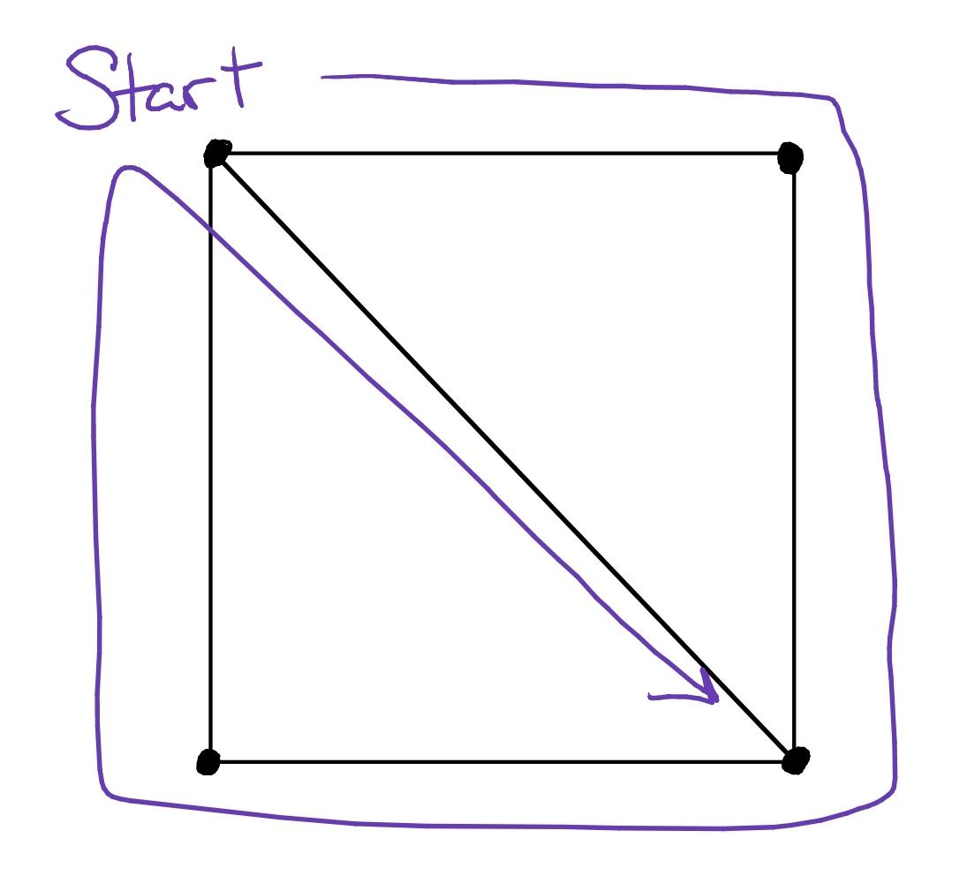
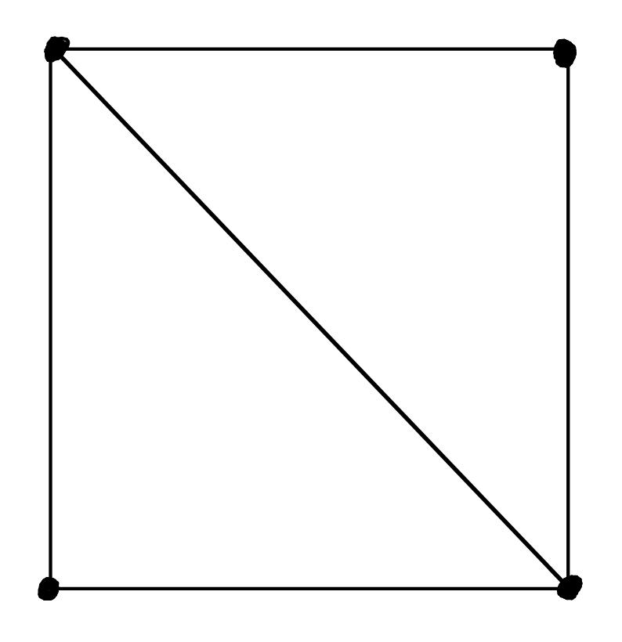
Euler Paths
An Euler path is one that goes through every edge in a graph exactly once.

Slide 8
Time for Break Out Rooms!

Slide 9
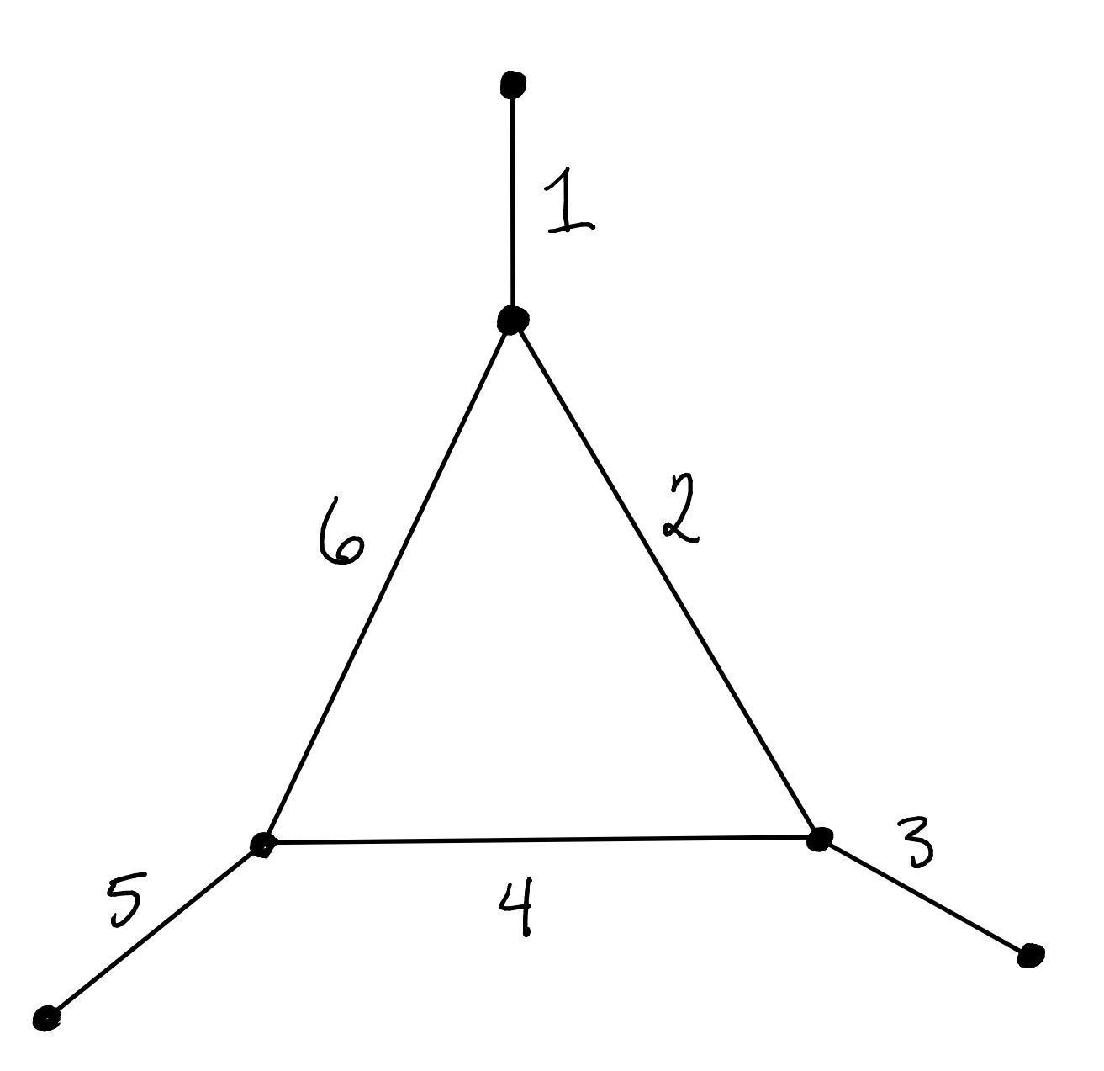
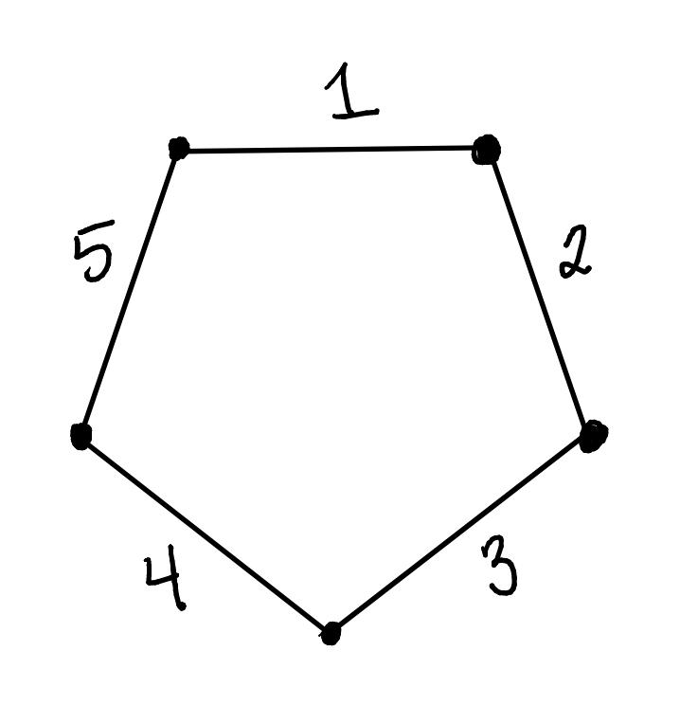
What about these two examples?

Slide 10
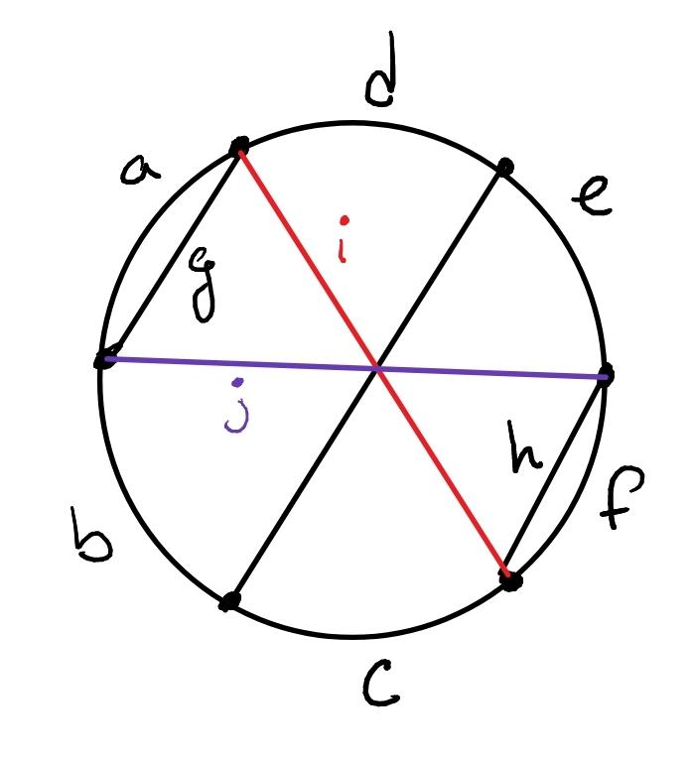
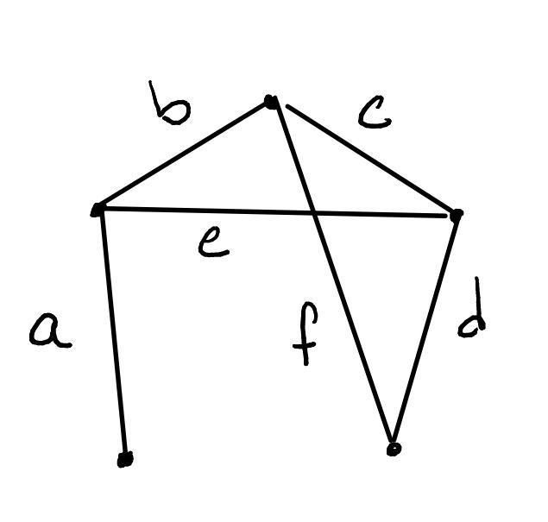
Does it matter where you start your path?

Slide 11
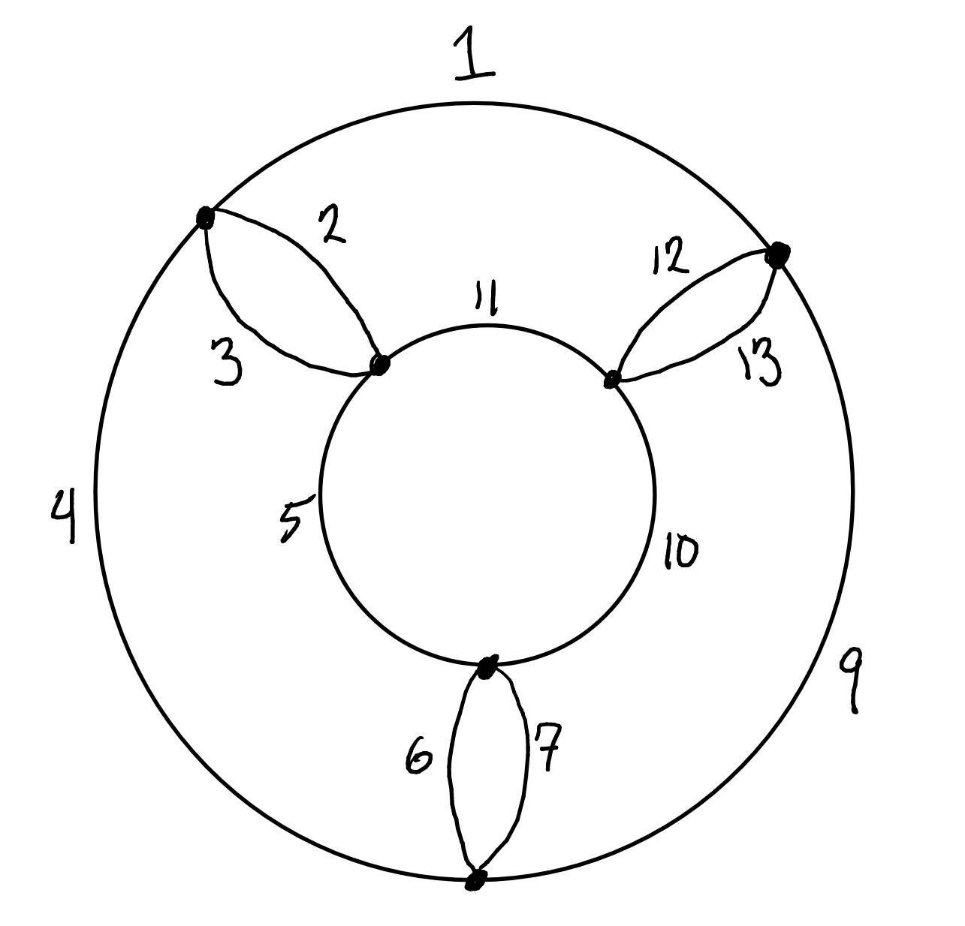
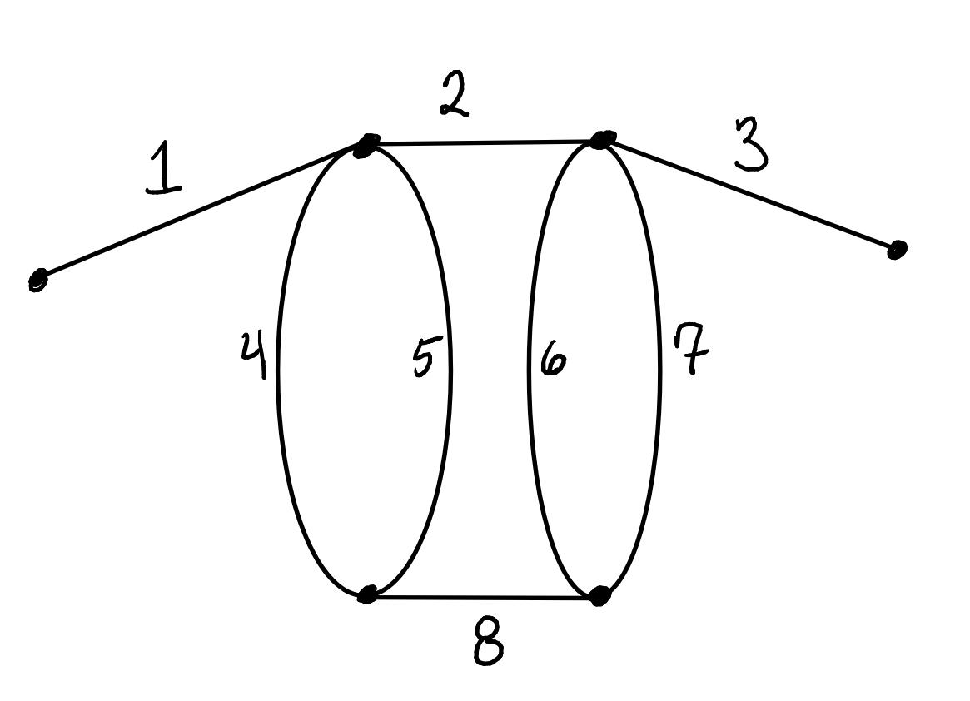
How about these ones?

Slide 12
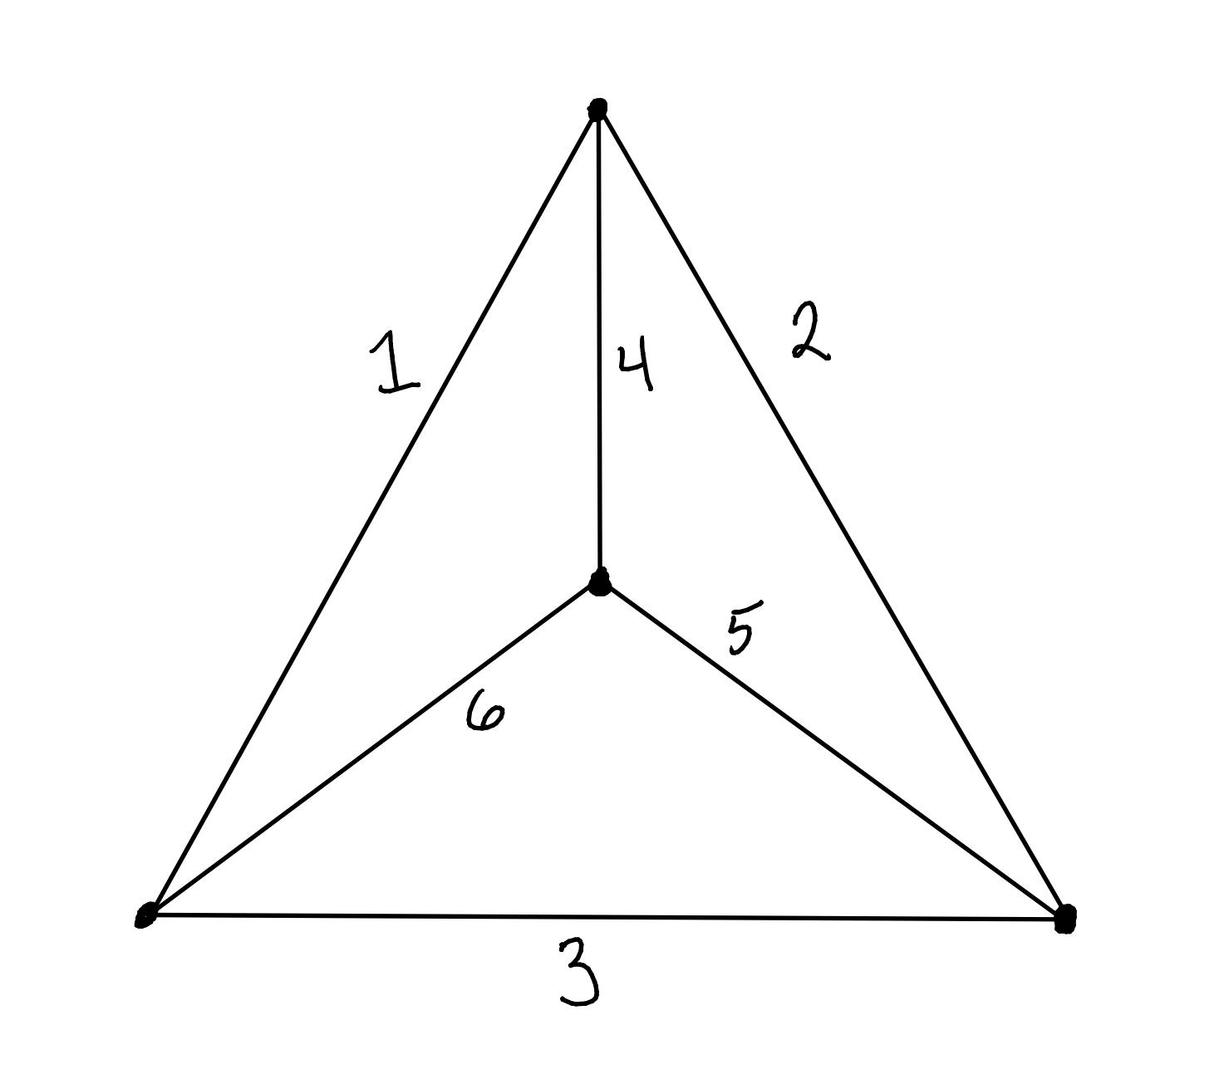
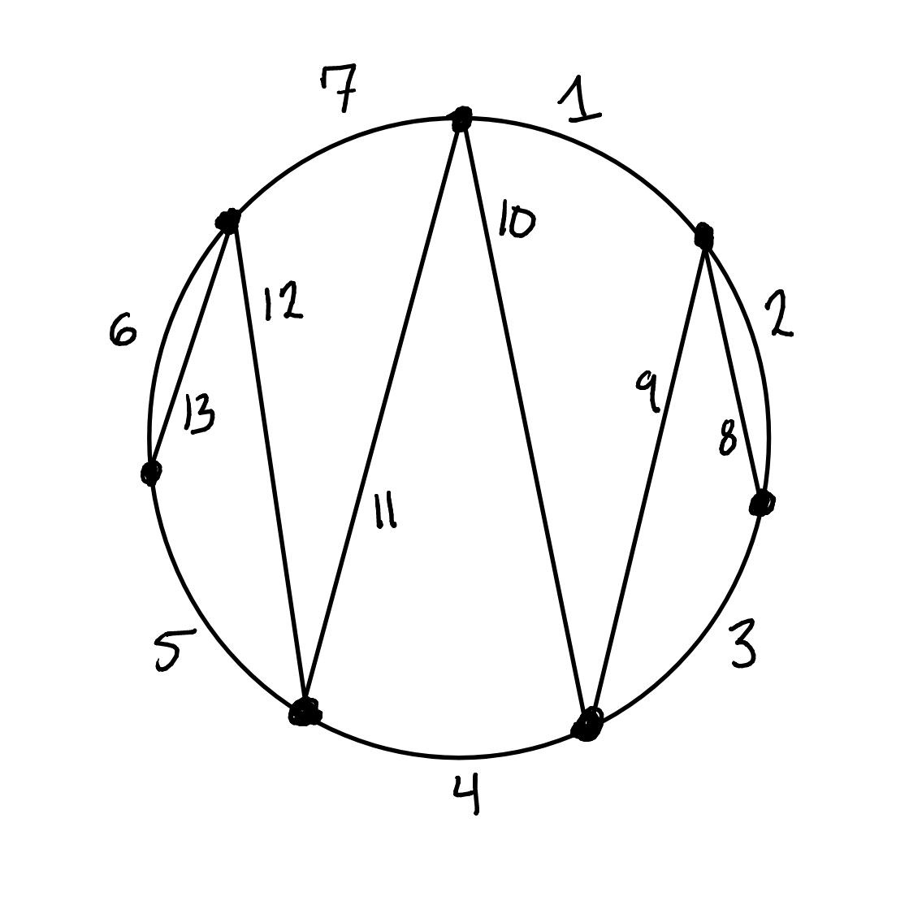
Harder Examples!

Slide 13
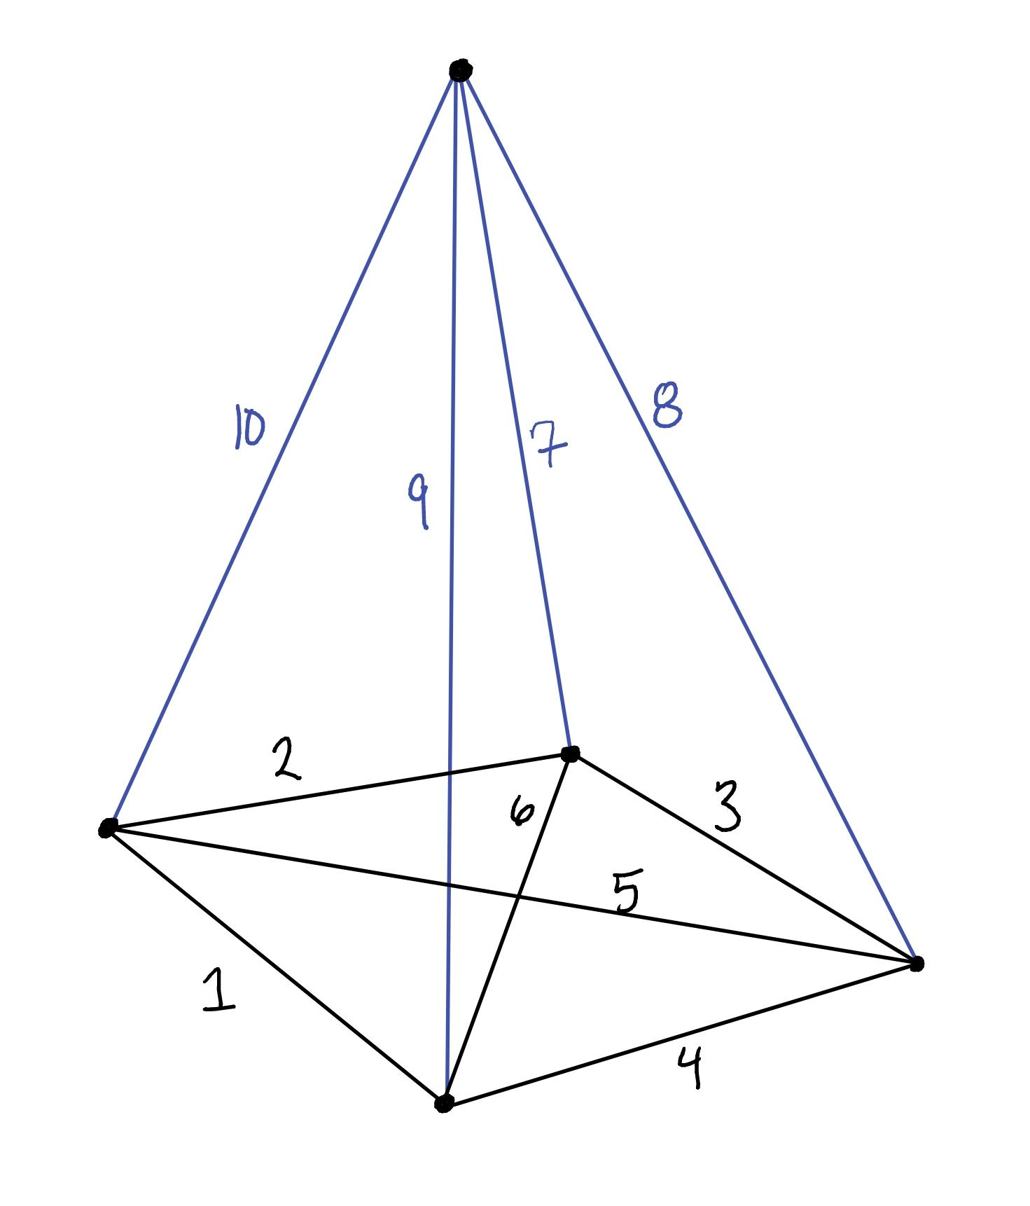
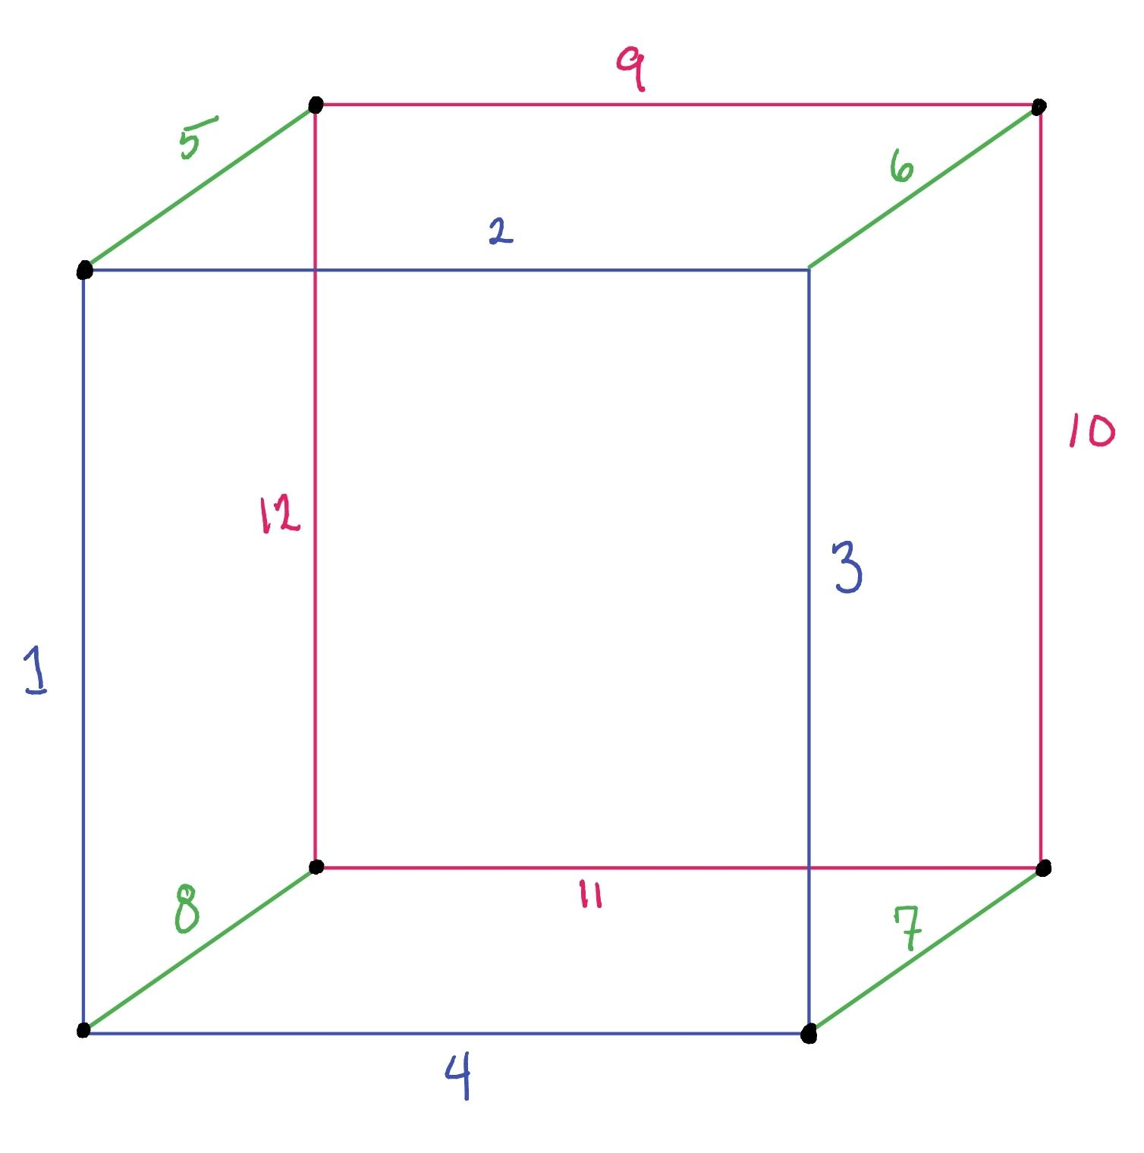
What about 3 Dimensional Shapes?

Slide 14
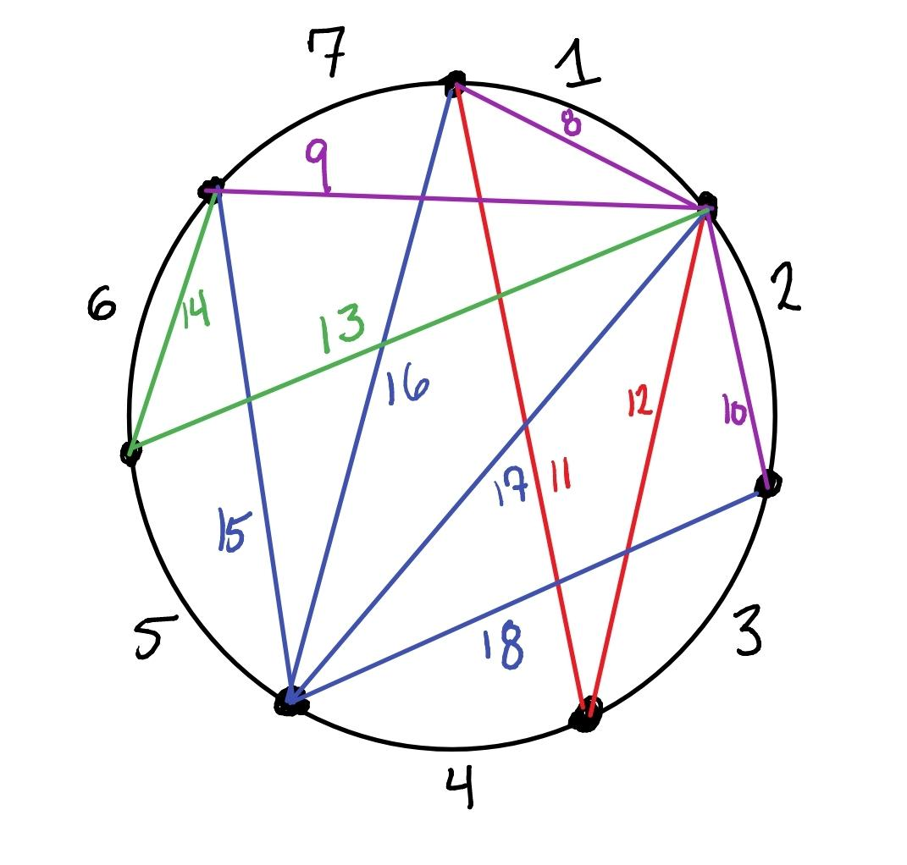
Challenge Graph!
Attempt if you want!

Slide 15
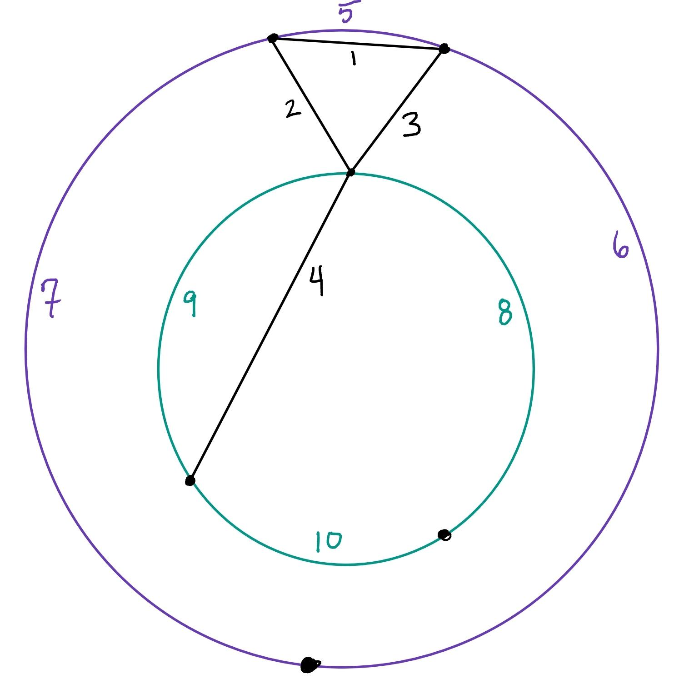
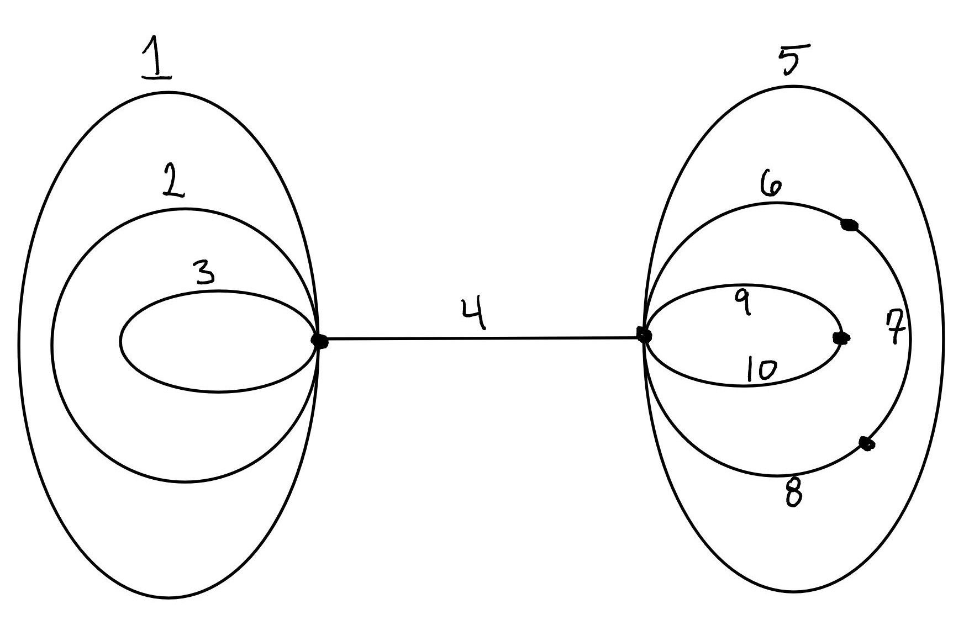
Loops!
If you are trying to make an Euler Path, do you care about loops? Why or why not?
Last slide of break out room!

Slide 16
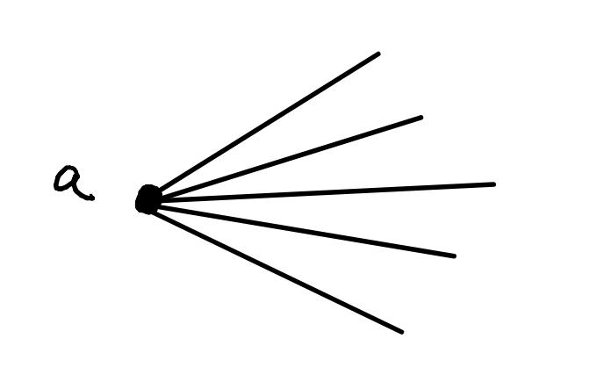
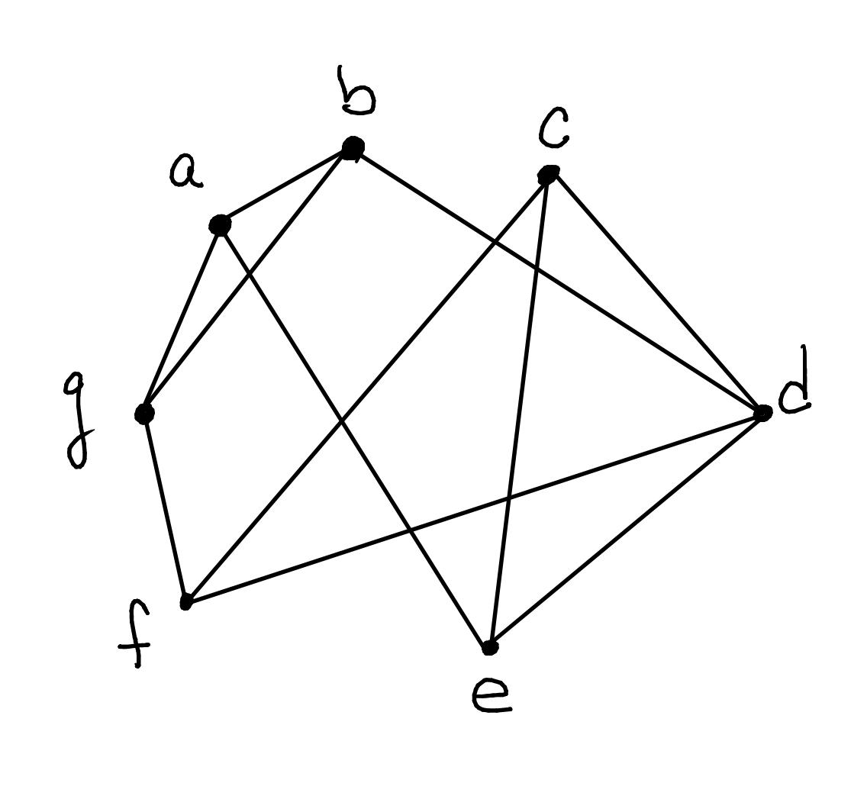
Last Tool We Need - The Degree of a Vertex
The degree of a vertex is the number of edges that connect to that vertex.
The vertex labeled a has degree 5
Which vertex has the largest degree, and what is the degree? Type it in the chat!

Slide 17
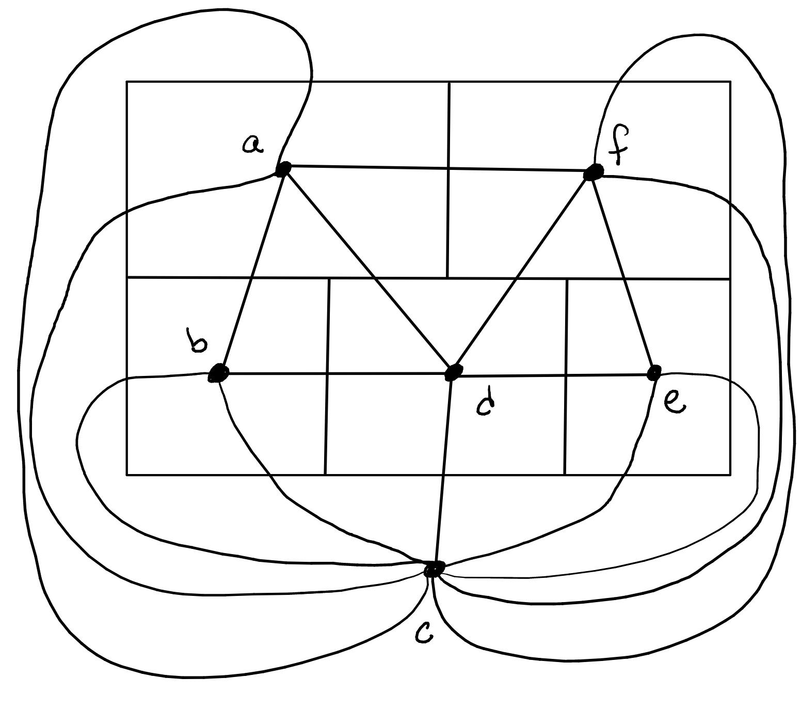
Solution
If a vertex has odd degree, the Euler Path has to start or stop at that vertex.
So if there are more than 2 vertices with odd degree, you cannot make an Euler path.

